Slide 1
SUPERSTORE DATA ANALYSIS
Sanjaikumar s
26/03/2025
Da & ds

Slide 2
Project Objective:
Analyzing sales data to identify trends, understand sales performance, and provide actionable business insights.
Goals:
Identify sales trends over different time periods (day-wise, year-wise).
Analyze sales performance across different product categories.
Understand the impact of discounts and profit margins.
Build a dynamic Excel dashboard with key sales metrics.

Slide 3
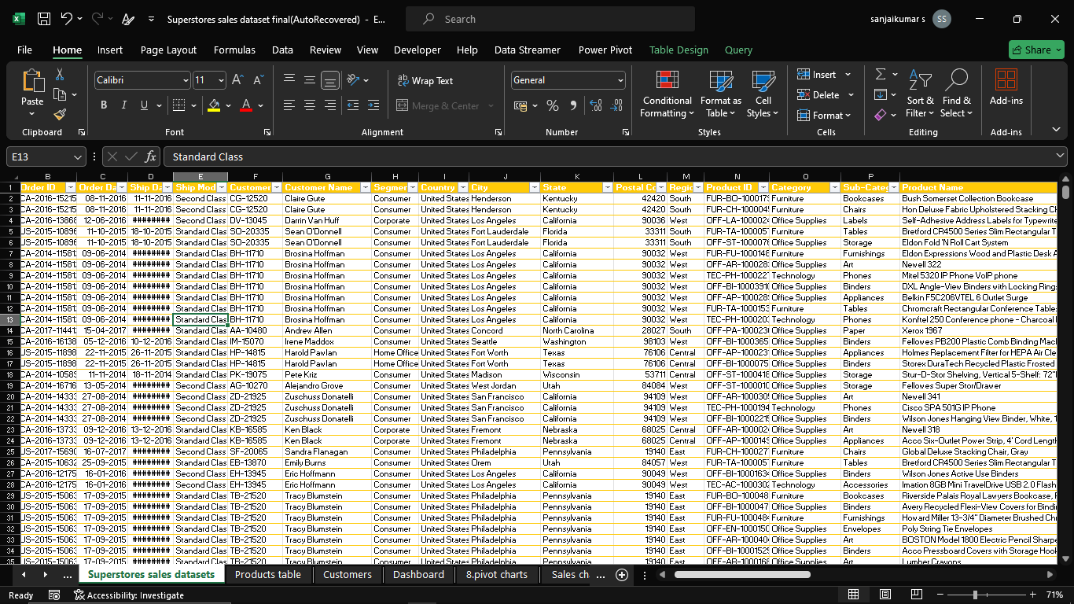
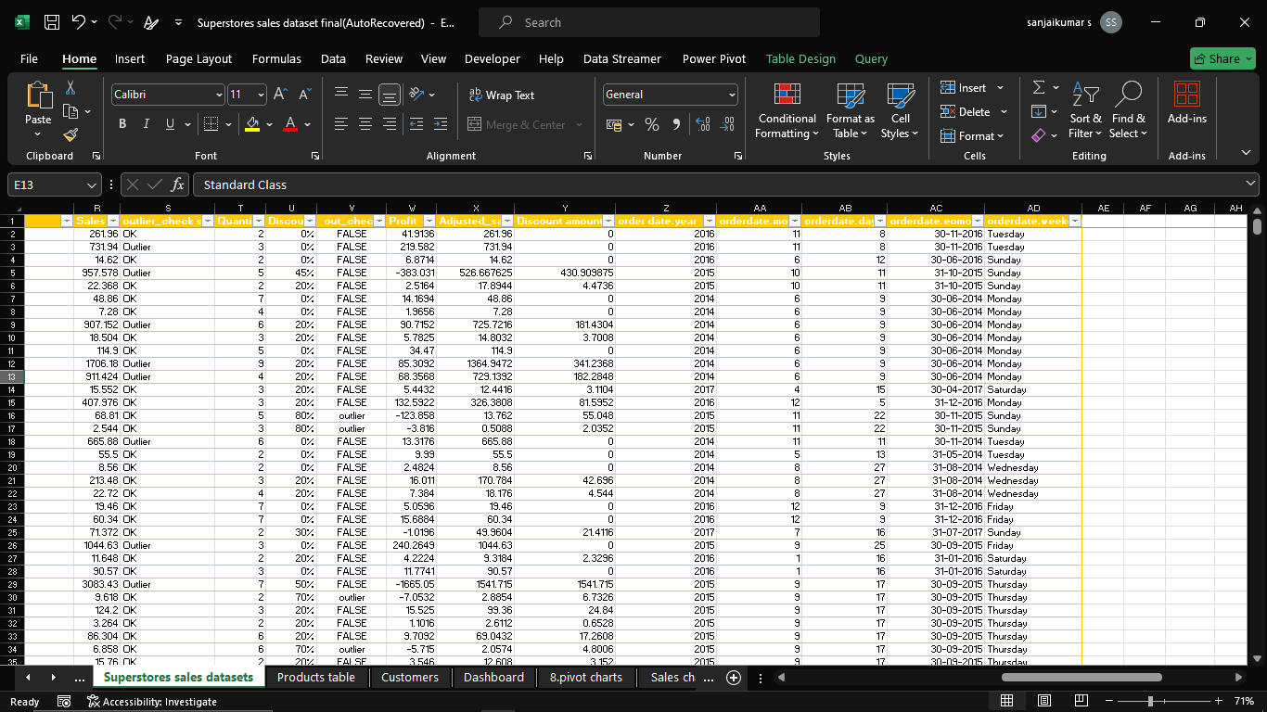
Dataset Overview:
The dataset contains multiple years of sales data with columns like Order Date, Ship Date, Category, Sales, Profit, Quantity, and Discount.
Data is grouped by year, product category, and days of the week.
Data Cleaning Process:
Removed missing values and duplicates.
Standardized date formats and ensured numerical consistency.
Checked for outliers in sales and profit.

Slide 4
Important Calculations:
Total Sales per year: 2017 had the highest sales.
Profit Analysis: Differences in profit across categories and days of the week.
Sales Performance by Category:
Technology had the highest sales but variable profit.
Office Supplies had stable sales but lower profit .
Discount & Profit Impact:
Higher discounts led to reduced profit in some cases.

Slide 5
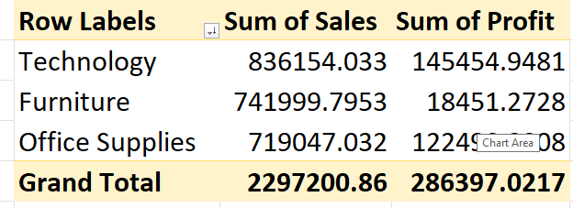
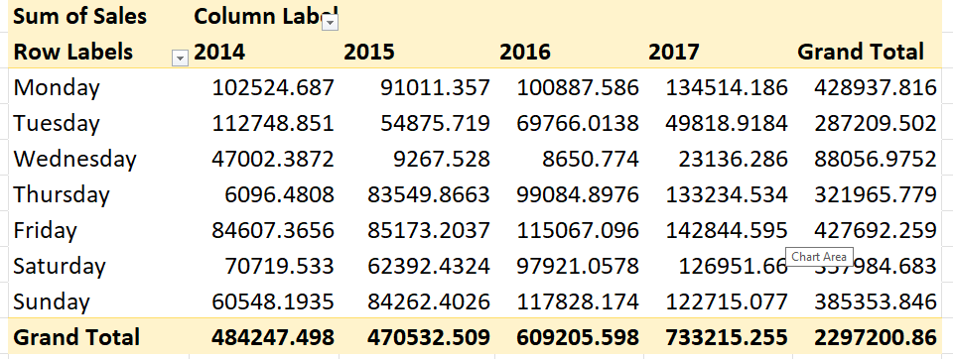
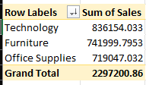
Pivot Table Insights:
Sales trends per year and weekday.
Sales performance across Furniture, Office Supplies, and Technology.
Total revenue and profit trends by category.
Pivot Chart Visualizations:
Sales and profit trends over different days.
Yearly growth comparison of total sales.

Slide 6
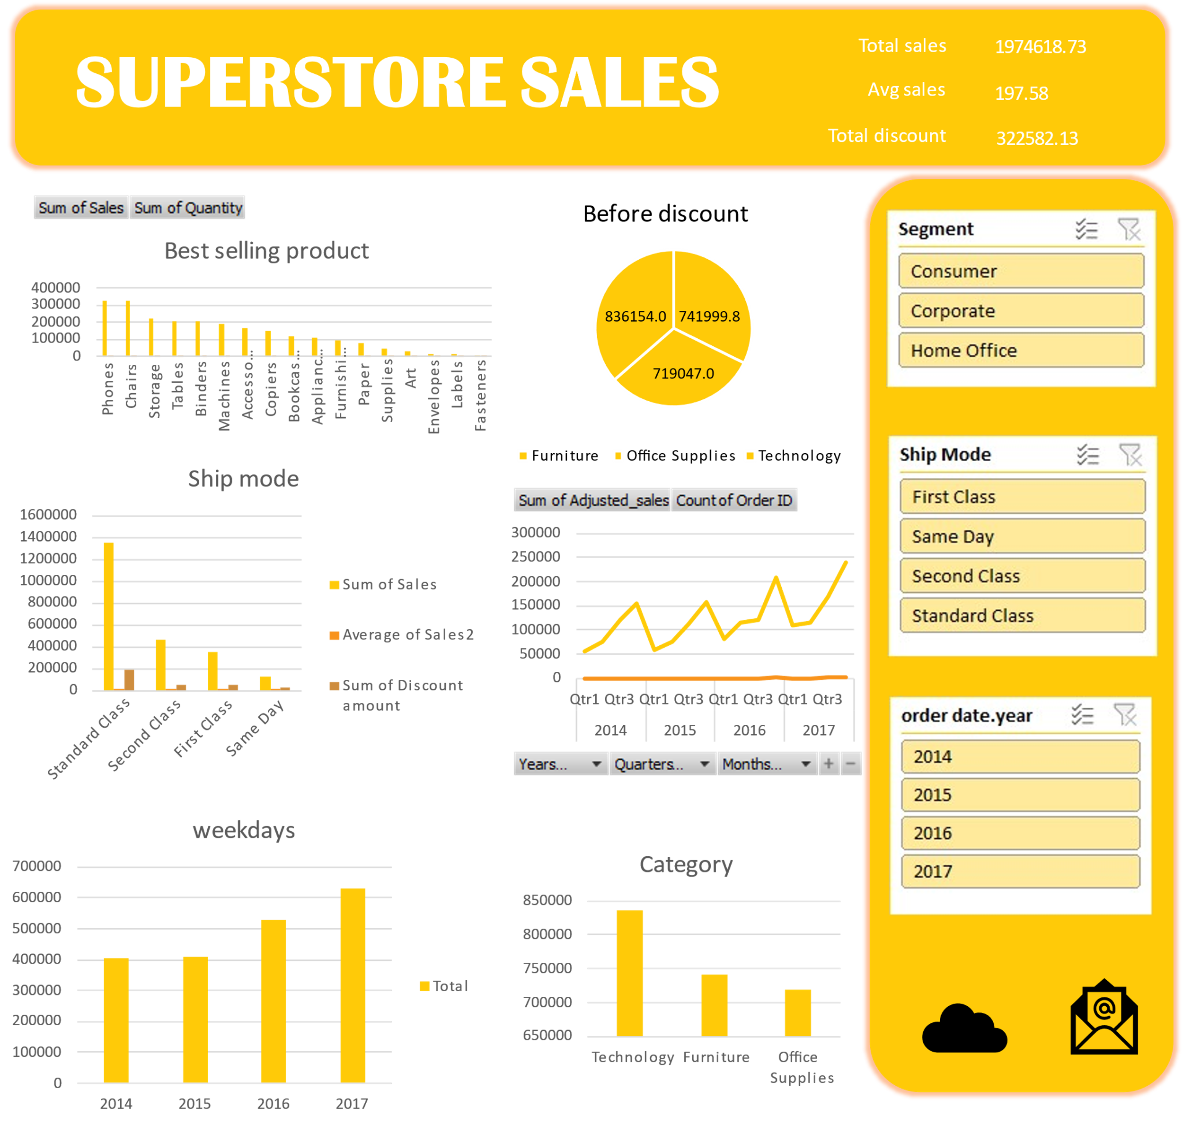
Dashboard Components:
KPIs Displayed:
Total Sales
Total Revenue
Best and Worst Performing Products
Category-wise sales
Interactivity:
Filters by year and category.

Slide 7
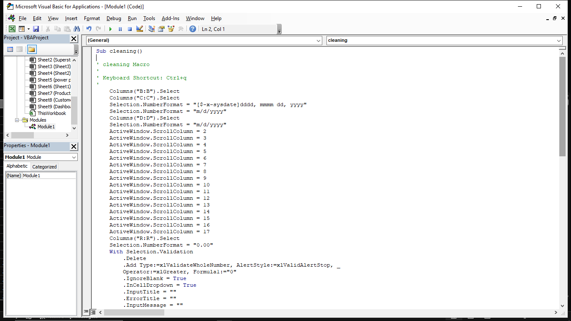
Macro Usage:
Automated calculations for sales and profit.
Used macros to refresh dashboards with one click.
Benefits of Automation:
Reduced manual errors.
Faster insights generation.

Slide 8
Key Insights:
Best Performing Category: Technology had the highest sales but fluctuating profit
margins.
Sales Trend: Sales were highest on Fridays & Mondays but profits varied.
Impact of Discounts: High discounts reduced profit margins in Office Supplies.
Recommendations:
Optimize discount strategy to maintain profitability.
Focus on high-profit categories for promotions.

Slide 9
Summary:
Sales Performance: Sales are highest in the Technology category, but profits fluctuate due to high discounts.
Best-Selling Periods: Sales peak on Fridays and Mondays, indicating potential high-demand periods for promotions.
Impact of Discounts: Higher discounts lead to increased sales but lower profit margins, requiring a better pricing strategy.
Optimization Needed: Adjusting discount rates and focusing on high-margin products can maximize revenue and profit.

Slide 10

THANK
YOU

